Slide 1
City Health Care Portal
Group Members –Avinash Kadam (220343120019)
Akshay Shinde (220343120008)
Pradyumna Sutar(220343120079)
Narayan Rawat(220343120064)
Project Guide – Mrs. Harshita Maheshwari

Slide 2
Contents
Introduction
System Analysis
Analyzing Modelling
Design
Testing
Proposed Approach
Screenshot
System Requirements
Applications
Advantages & Limitations
Conclusion
Future Scopes
References

Slide 3
Introduction
Cityhealthcare is a web based application connecting all hospitals in the city. With this applicationpeople can get the information of nearby hospital location wise.
This application enables the health providers to provide the operational health care and check availability (Doctors,Oxygen,Blood), reduce time consumption and enhance delivery of quality of care.
The application has facilities to store and provide the details of hospital records of the requirements (for e.g.: Oxygen, Bed, Ventilator, Blood Availability in the hospital). I.
The Cityhealthcare application is designed for the peoples during the pandemic condition like Covid19. Farmers & admin can add different products.

Slide 4
System Analysis
Functional Requirements
Performance Requirements
Safety Requirements
Security Requirements
Availability
Accessibility
Effectiveness

Slide 5
Proposed System
AIM:
1. It will help patient and user
Proposed System:
1. Digitalize HealthCare
2. Communication can take place even through mobile
3. Through this project patient get better healthcare facility

Slide 6
Methodology
The objective is to create a web based app that can perform the following:-
Connecting to an HTTPS site through Server.
Opening the relevant react page using HTTPS POST & GET methods.
Read the data logically into user, patient and admin.
Creating a local database.

Slide 7
There are Three main modules:
Admin | user | Hospital
Add Hospitals | Registration ,login | Add Bed
View Hospital | Bed Booking, Blood Details | Add blood details
View user | Doctor info, Ambulence | Add doctors details
 | Status | Add doctor info

Slide 8
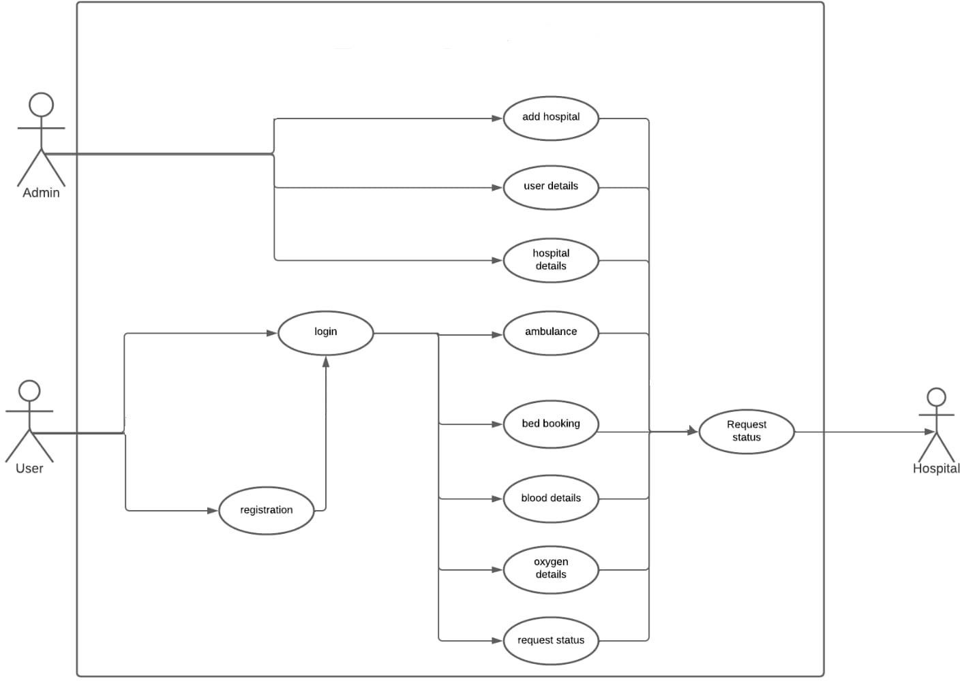
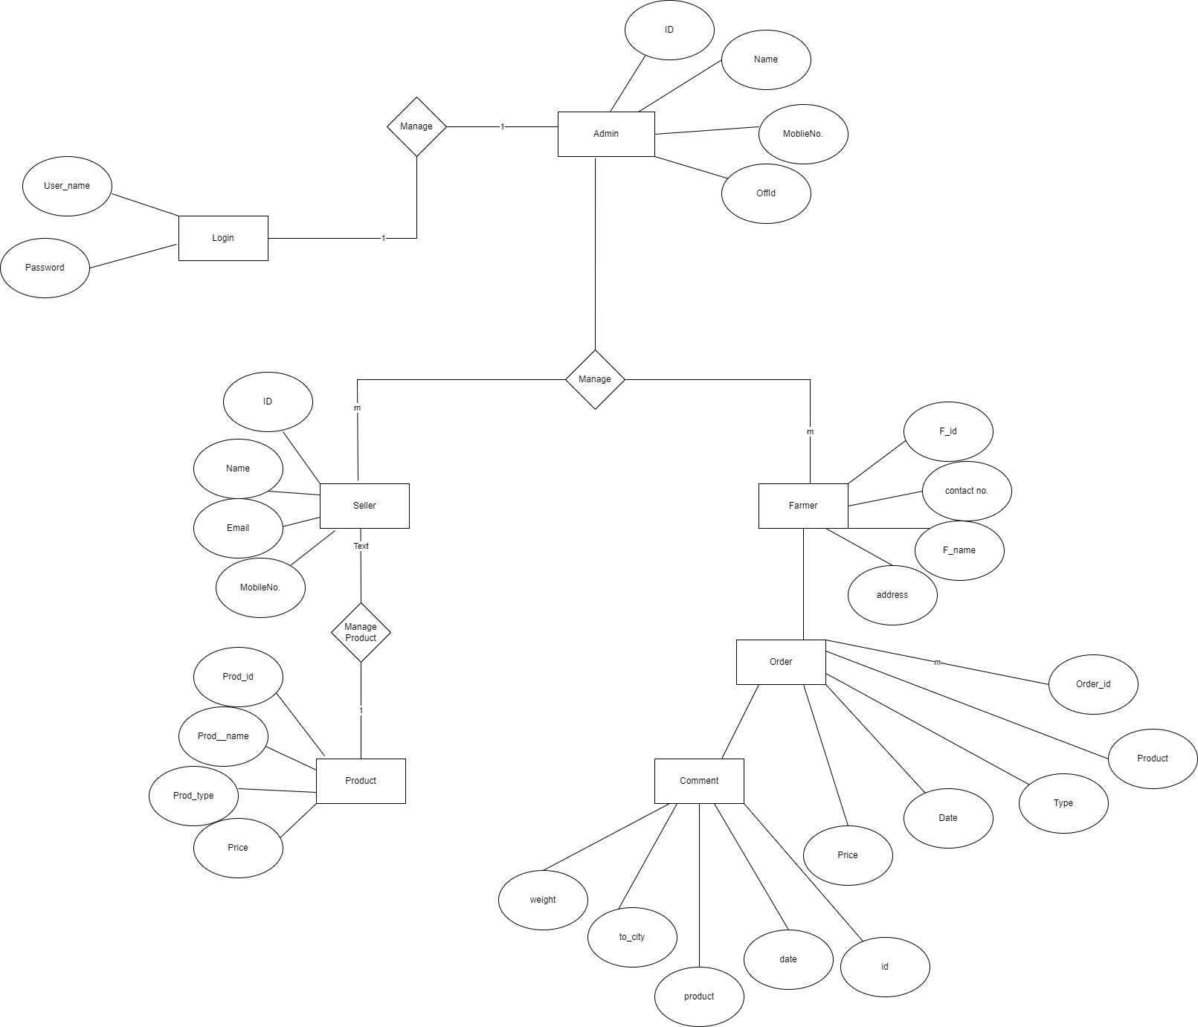
Use case diagram

Slide 9
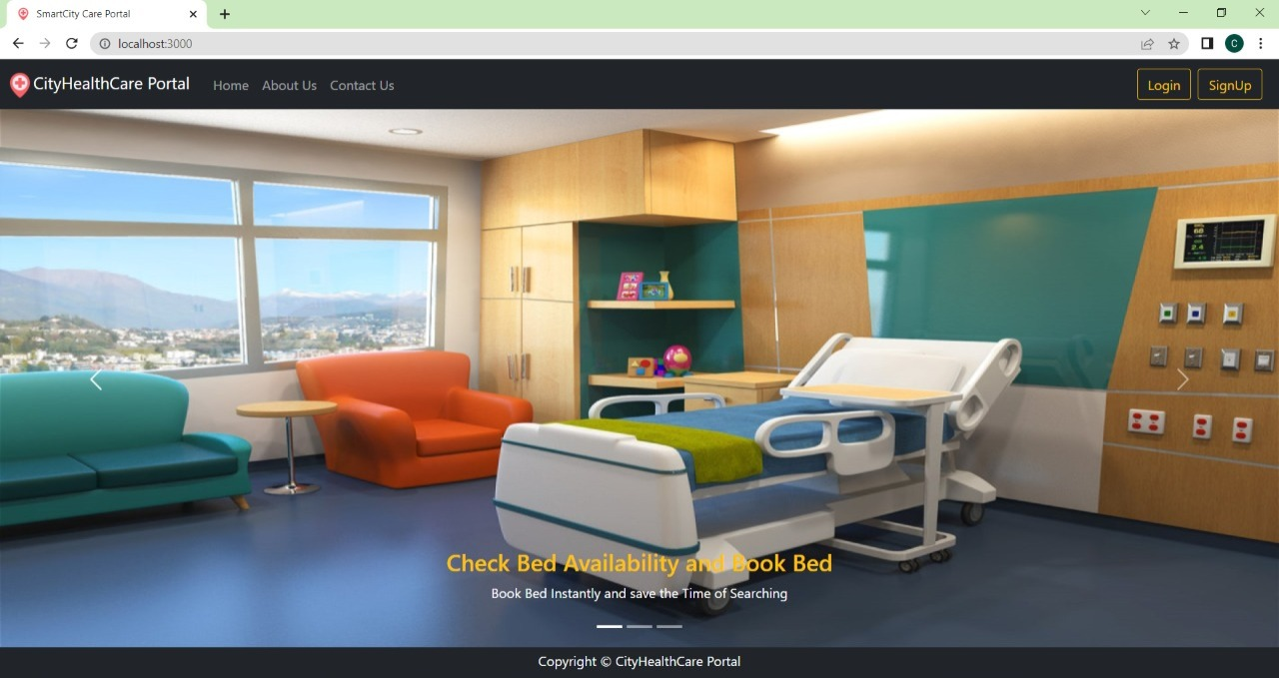

Slide 10
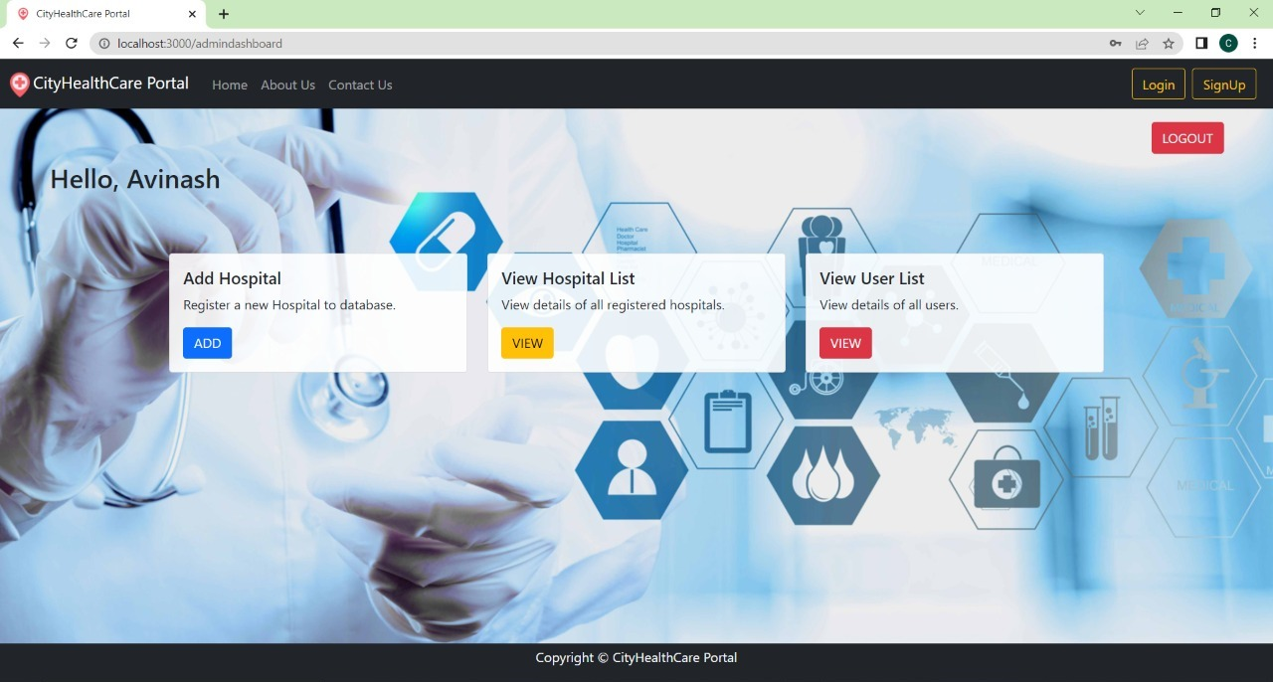

Slide 11
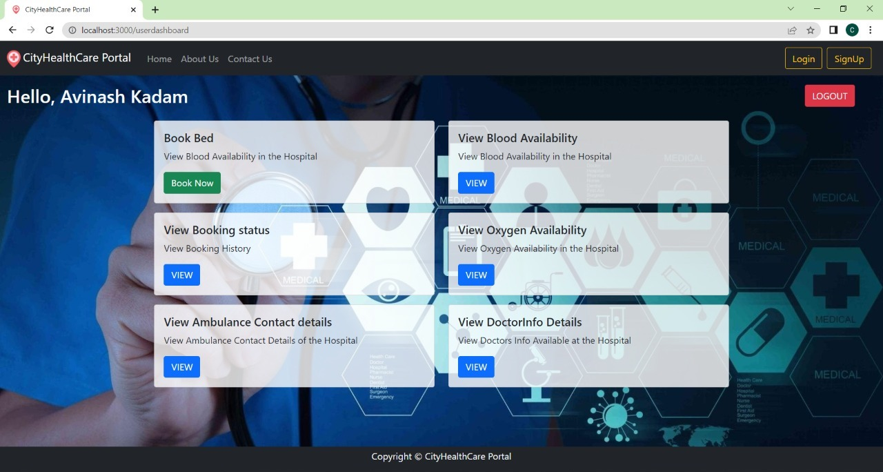

Slide 12
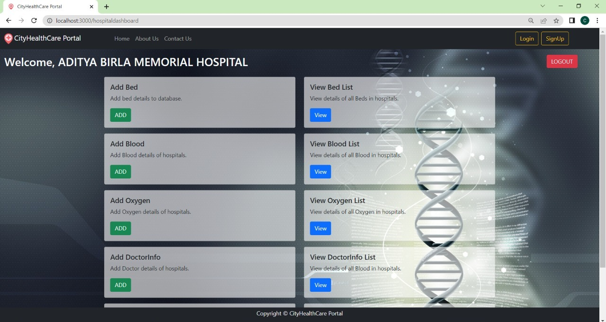

Slide 13
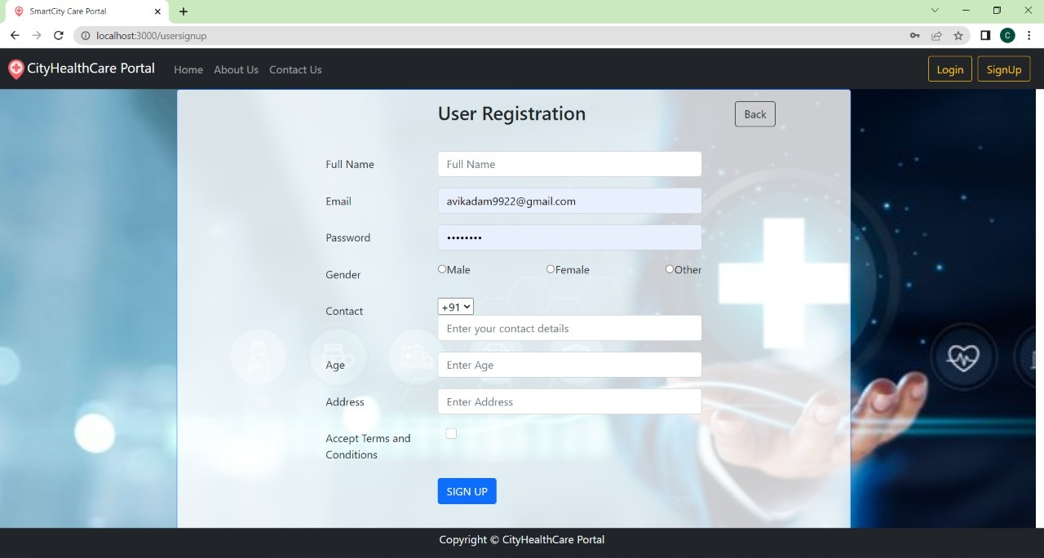

Slide 14
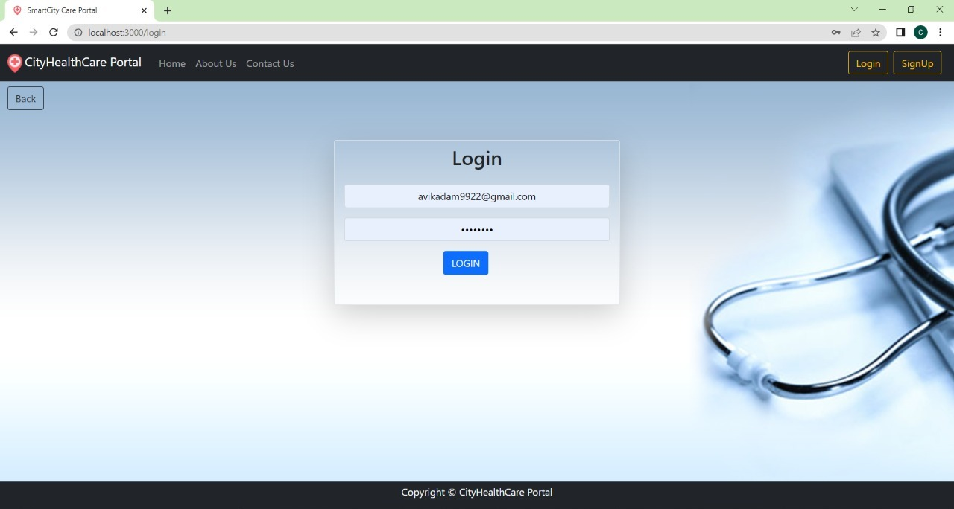

Slide 15
System Requirements
Software Requirements:
• Windows 10
• Tomcat 9
• Eclipse, MySQL, XAMMP
Hardware Components:
• Processor – i5
• Hard Disk – 1 TB
• Memory – 4GB RAM

Slide 16
Technologies Used
HTML : Page Layout has been designed in HTML.
CSS : Used for all designing part.
JavaScript : All Validation task and animations has been developed by JS.
React JS : All front end logic has been written in React JS.
Spring Boot: All the business logic has been written in JAVA.
MySQL : MySQL database has been used as database.

Slide 17
Applications
Digitized Healthcare sector
Can be used in other cities
Provides the Cityhealthcare assistance to the user and patient

Slide 18
Advantages
Time Saving Application
Cost Effective and easily manageable
Data Security
Maintains Data of user and hospital

Slide 19
Limitations
Accurate verification of the users cannot be done online.
It requires an extensive database and memory.

Slide 20
Conclusion
Taking into account all the mentioned details, we can make the conclusion that the Cityhealthcare portal system is the inevitable part of the lifecycle of the modern medical institution. It automates the operations while having emergency during the pandemic situations. Developing the Cityhealthcare portal software is a great opportunity to create the distinct, efficient, and fast delivering health care model. Implementation of Cityhealthcare portal project helps to store all the kinds of records, provide coordination and user communication. This beneficial decision covers the needs of the user and simplifies their interactions with the hospital.

Slide 21
Future Scope
Verification of users.
Improvement in design.
Mobile Application
UPI payment
Integration of new function like user can eligible for online consultant

Slide 22
References
Mr. Saleel Bagde for Database.
Mrs. Harshita Maheshwari for HTML JS & CSS also she was our project guide.
Mrs. Mayuri for Spring Boot & JAVA.
https://www.slideshare.net
https://www.projectideas.co.in
Europol report, 2016
International Conference on I2C2, 2017
A special thanks to Infoway Management who arranged extra lab time for us.

Slide 23
THANK YOU

